Slide 1



Three Ways of DevOps
@smileandeliver
Notes:
[Title Slide]
[Instructions for Facilitator]
The workshop consists of a short talk followed by a workshop session. During the workshop session, the delegates will choose one of three groups: Gods, Reporters or Geniuses.
You will need three places for your workgroups to gather and collate their ideas, so three sets of postits and/or three flipcharts would be ideal (flipcharts are easiest for feedback session at the end)
You can run this solo but it works best if there are three facilitators, one for each work group to help encourage everyone to participate. During the work group time, the best ideas come out if the presenter/facilitator steps away for a bit, then walks round with encouragement and to answer any questions, about half way through,
This can be run for any length of time between half an hour and two hours. Around one hour is ideal.

Slide 2


I am…
Alex Moore
Senior System Build Engineer
TransUnion UK
Twitter @smileandeliver
GitHub https://github.com/smileandeliver/

Slide 3
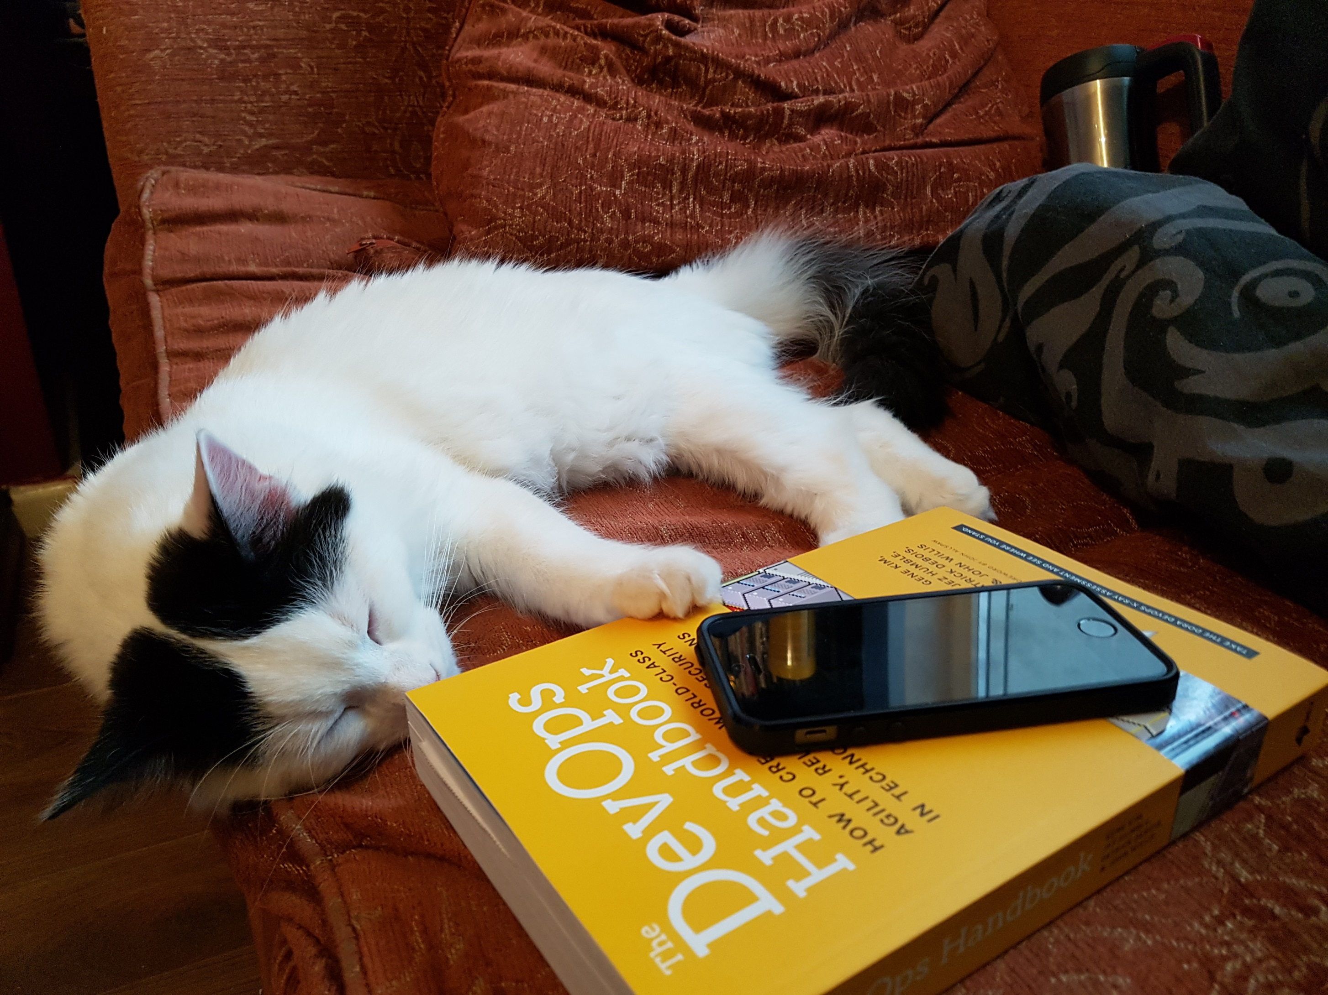
@smileandeliver
Notes:
Quick question to the room to gauge who is in the room? Dev? Ops? Test? Sec? Sales? Tech Consultants? Architects? Support?
How much do they already know of DevOps? We’re going to talk a bit about the principles of DevOps today. First, the CALMS model and then the main focus of this workshop, the Three Ways of DevOps.
Don’t worry about taking everything in, just relax and listen for now. After a really short talk, we’ll split up into three groups and talk about ways we can all apply the Three Ways in our work, it’s not just for Dev and Ops.
(By the end of this, you’ll love it as much as Rollins the cat)

Slide 4




Dev
Ops
@smileandeliver
Notes:
What’s the Point of DevOps?
This might be a slide you’ve seen a few times before and it is a brilliant, very much oversimplified way of describing the original problem that DevOps was designed to address. Devs writing code, want their changes into prod. Ops don’t want prod to break.
That‘s often more about the way the teams are incentivised; Devs are paid to create new features whereas Ops usually have targets around uptime/availability.
How can we have both change and stability…
(Can talk about the history of DevOpsDays a bit as well if there’s time)

Slide 5
Culture
Freedom to experiment and make changes
Flatter Organisational Structure
Automation
Continuous Integration / Scripted Delivery Pipelines
Infrastructure as Code
Lean
Understand what value is and focus on delivering it
Commit often, deploy swiftly
Measurement
Capture, understand and share metrics
Demonstrable improvements over time
Sharing
Share information and learn together
Collaborate and communicate across teams/functions
@smileandeliver
Notes:
Ultra briefly talk through the CALMS model, emphasising the points you feel are most relevant to the specific audience.

Slide 6


“3 ways” of DevOps
Dev
Ops
Dev
Ops
Dev
Ops
@smileandeliver
Notes:
The concept of three underpinning ways of DevOps was described in “The Phoenix Project” by Gene Kim, Kevin Behr and George Spafford. These are the focus of this workshop –
Again, don’t worry about remembering everything just now, just let the ideas flow and all the info you need will be available at the end.
Each of these arrows represents a flow of activity, value and communication. Let’s break each one down.
For each Way, we’re going to assign a personality to it. As we go through, if there’s a particular personality that jumps out at you, as one you identify with or are curious about – maybe you’d like to join that group when we break out into work groups.

Slide 7
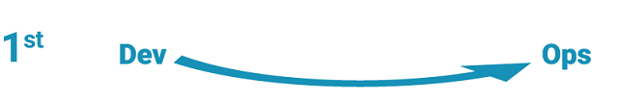
The First Way
Systems Thinking
@smileandeliver
Notes:
The First Way
Emphasizes the performance of the entire system, as opposed to the performance of a specific silo of work or department.
Outcomes
- Never passing a known defect to downstream work centres
- Never allowing local optimization to create global degradation
- Always seeking to increase flow
- Always seeking to achieve profound understanding of the system
The First way is like being a GOD; you are everywhere, you see everything, the good and the bad. You seek to improve…

Slide 8
The Second Way
Amplify Feedback Loops
Ops
Dev
@smileandeliver
Notes:
The Second Way
With almost any process improvement initiative, the goal is to shorten and amplify feedback loops so necessary corrections can be continually made.
Outcomes
- Understanding and responding to all customers, internal and external
- Shortening and amplifying all feedback loops
- Embedding knowledge where you need it
The second way is like being a passionate, investigative REPORTER, you’re driven to make sure that you have the right information and that it gets to the right people, in the most relevant and interesting way

Slide 9

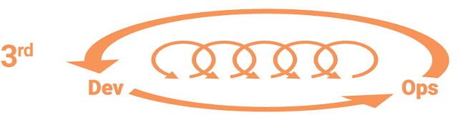
The Third Way
Culture of continual experimentation and learning
@smileandeliver
Notes:
The Third Way
Involves creating a culture that fosters two things:
- Continual experimentation, which requires taking risks and learning from success and failure
- Understanding that repetition and practice are the prerequisites to mastery
Outcomes
- Allocating time for the improvement of daily work
- Creating rituals that reward the team for taking risks
- Introducing faults into the system to increase resilience
The Third Way is like being a scientist, a GENIUS, who is compelled to continuously experiment, to learn and progress.

Slide 10

Gods
The First Way
Systems Thinking
The Second Way
Reporters
Amplify Feedback Loops
The Third Way
Geniuses
Culture of continual experimentation and learning
@smileandeliver
Notes:
[This slide is animated ‘on click’ for the words Gods, Reporters, Geniuses to appear]
Time to split up into your three groups – Think about the ‘way’ that you have chosen; what ideas do you have – or what changes could you make in your organisation which will facilitate and promote your way.
In DevOps, you need all three of these for success! But right now, just go with yours
I will leave a video loop playing so that you can get a reminder of each ‘way’ and what it means, if you need it. Don’t be too tied down by these definitions – just write down any ideas for improvement as they occur to you.
(Direct participants to their flipcharts or whiteboards)
You have x minutes – please feel free to ask anything as you go

Slide 11

@smileandeliver
Notes:
[This slide is not blank; Video will play automatically. Leave it on the screen while the groups compile their ideas]

Slide 12
Gods
The First Way
Systems Thinking
The Second Way
Reporters
Amplify Feedback Loops
The Third Way
Geniuses
Culture of continual experimentation and learning
@smileandeliver
Notes:
Feedback from each group, get them to talk through their ideas briefly

Slide 13


@smileandeliver
https://github.com/smileandeliver/
http://teamguidesforsoftware.com
https://leanpub.com/SoftwareOperability/c/DevTestNorth20

